Slide 1

British inventors and their inventions
Wojciech Krakowiak i Marcel Mikołajczyk

Slide 2
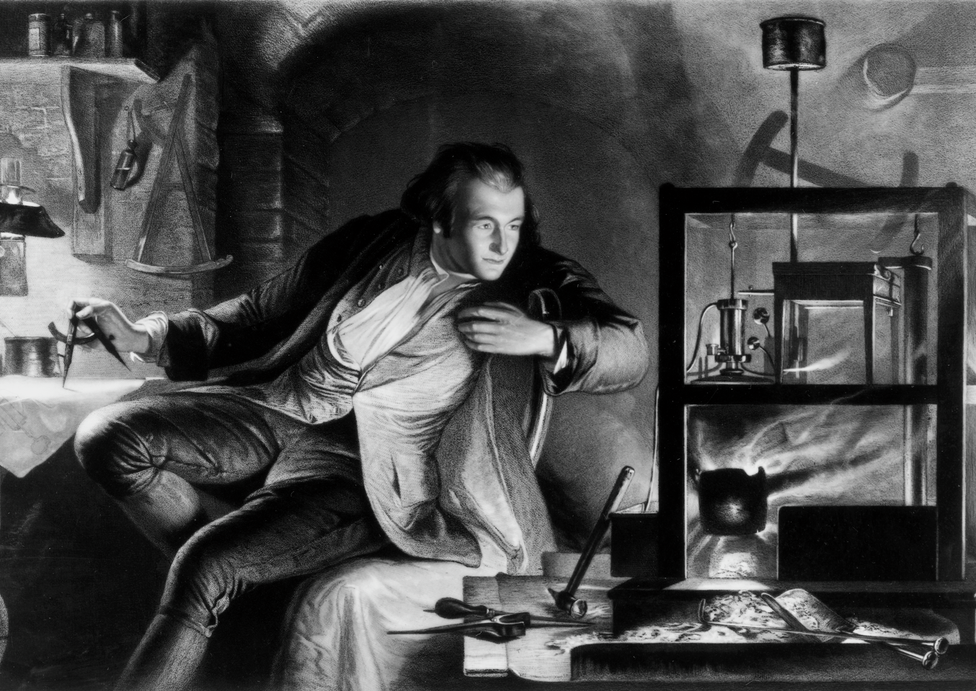
James Watt
Scottish engineer and an inventor living between 1736 and 1819
His invention (1769), the steam engine had revolutionized transportation at the time allowing large cargo to be moved quickly
This invention paved the way to a present-day engine

Slide 3
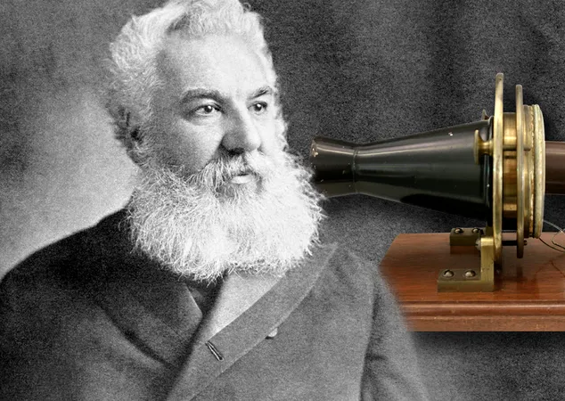
Alexander Graham Bell
A Scottish scientist and an inventor living between 1847 and 1922
His invention, the telephone (1876), improved communication and allowed people to contact each other effortlessly
Thanks to this innovation, it became possible to create modern cell phones.

Slide 4
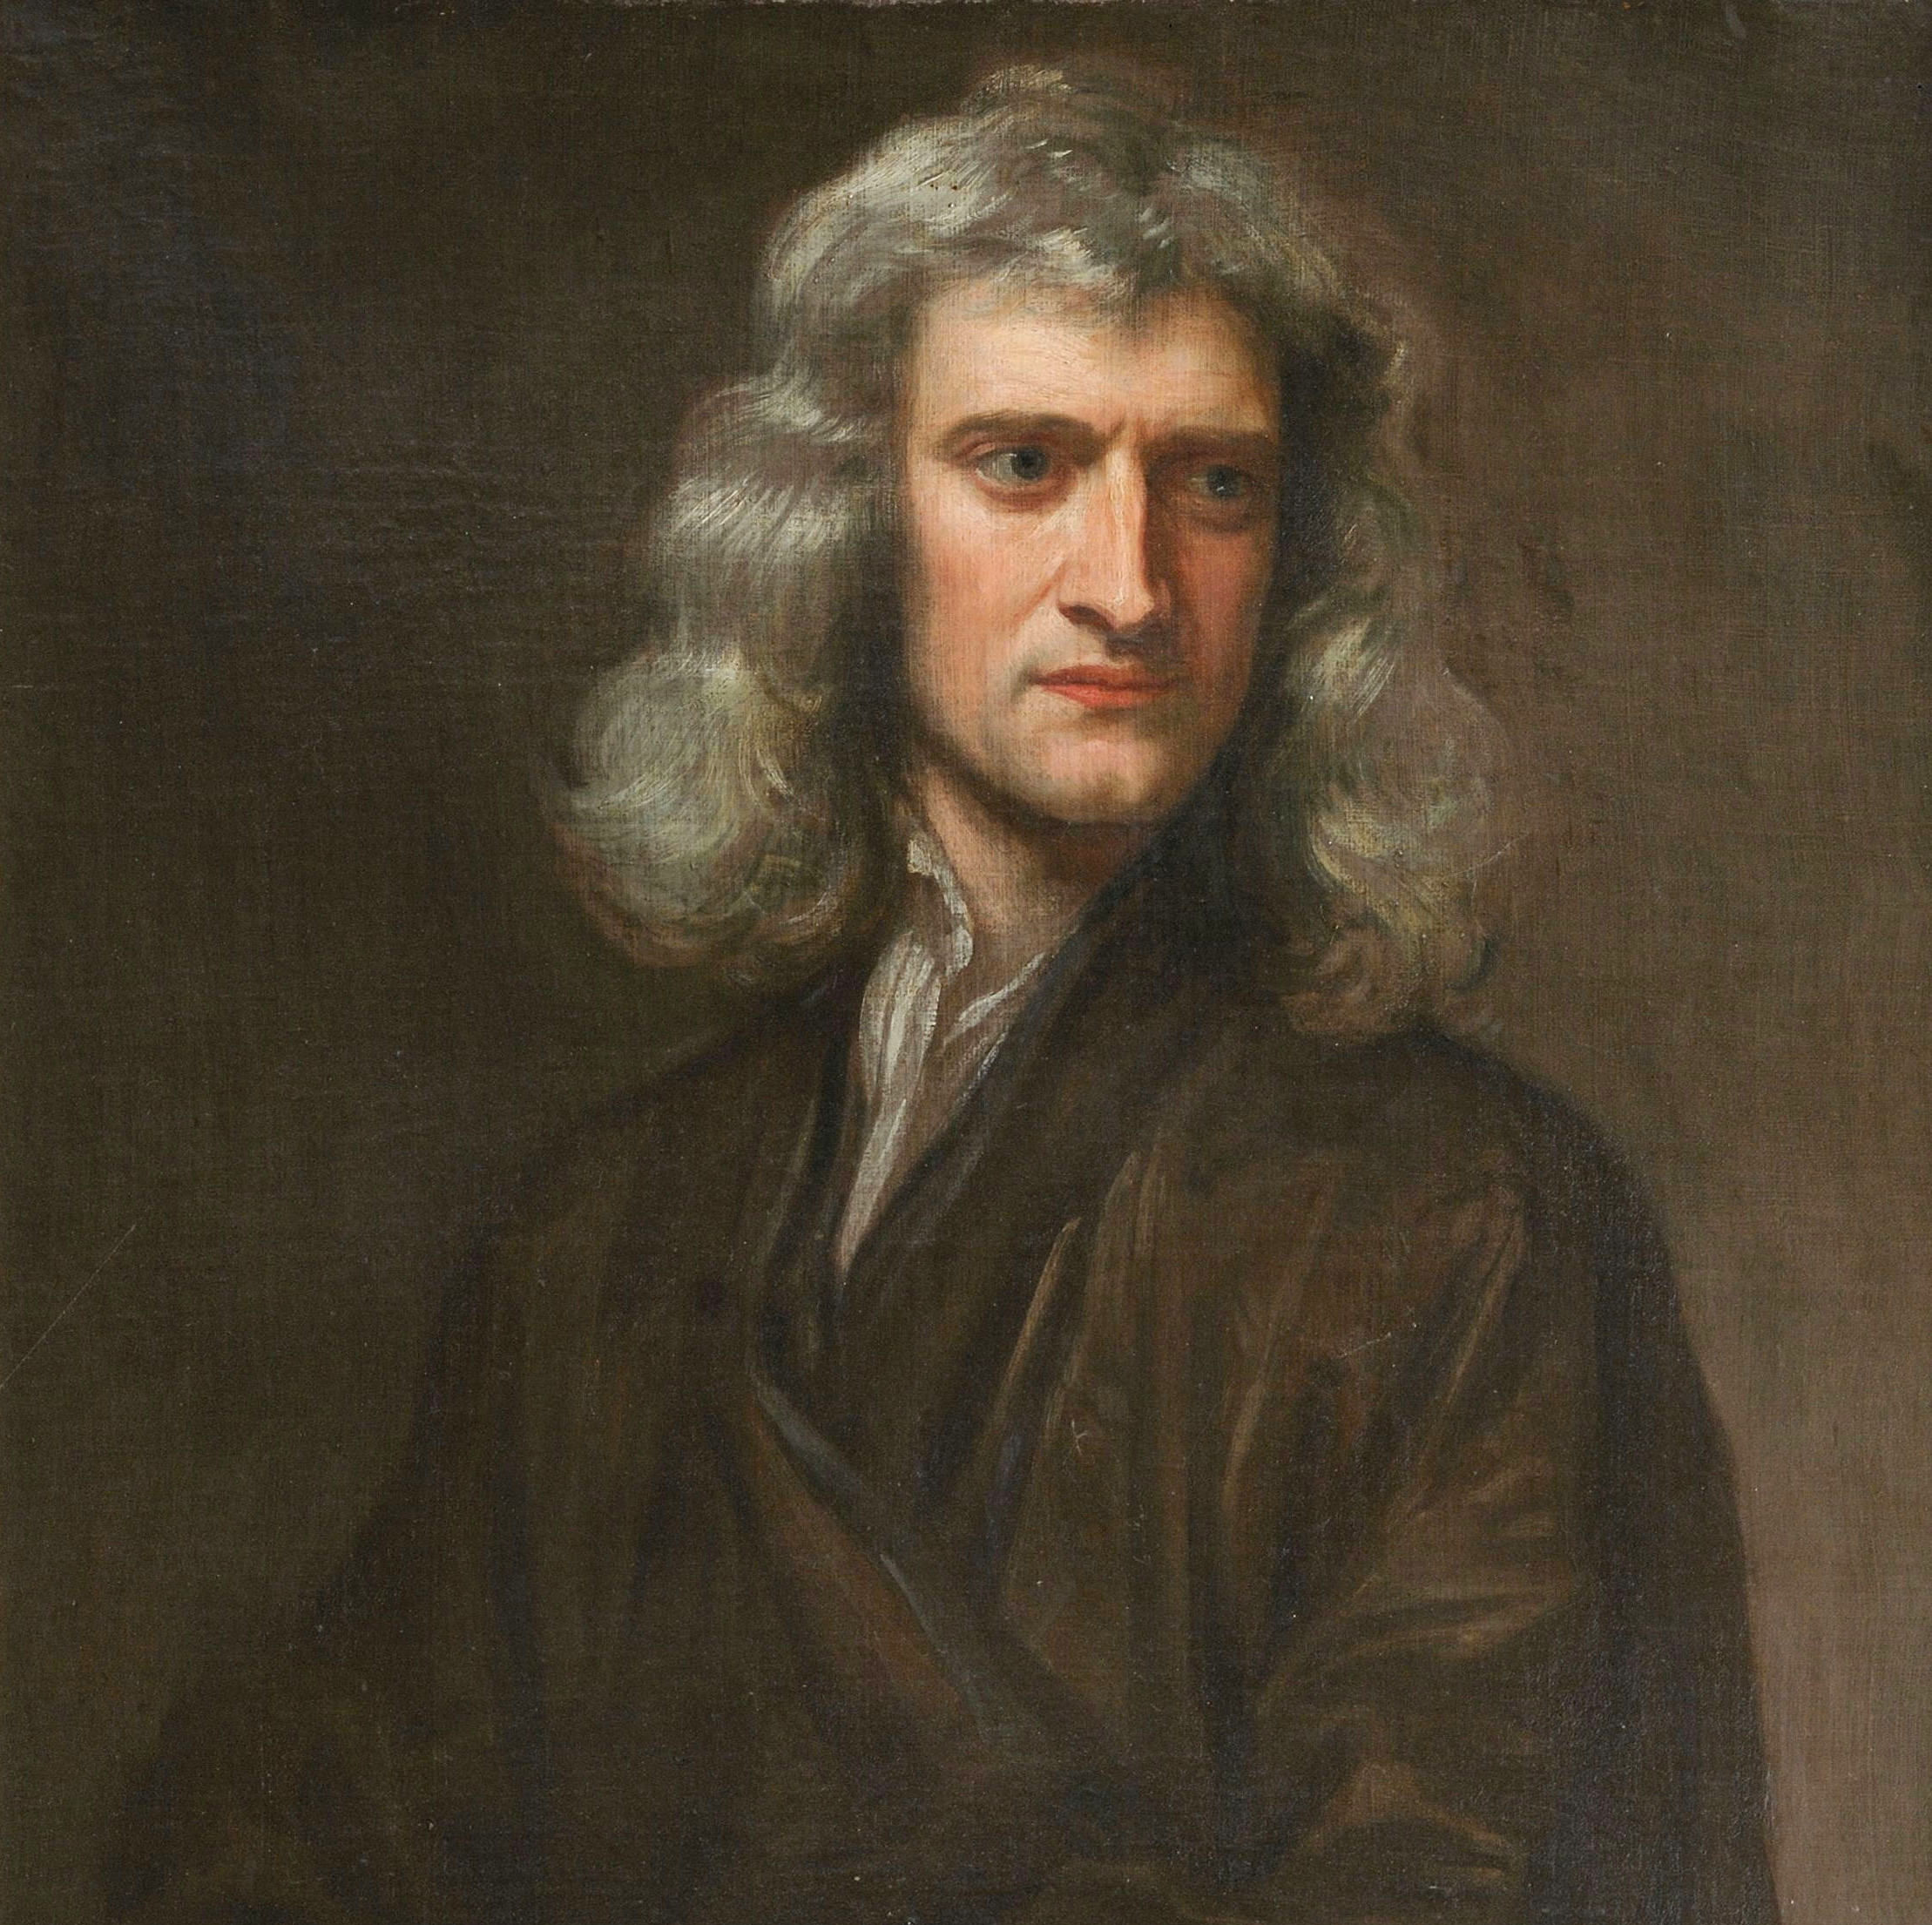
Isaac Newton
English physicist and a chemist living between 1643 and 1727, who discovered gravity (1687)
Formulated the three laws of Newton’s motion

Slide 5
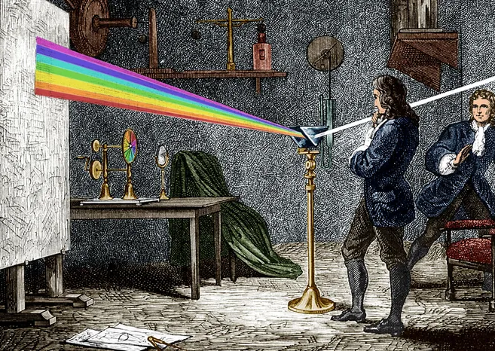
Isaac Newton
He also discovered the colour theory (1666)
It laid the groundwork for modern optics, transformed optics into a science and opened new windows into the universe

Slide 6

Honourable mention: Harrier jump jet
Revolutionary fighter jet developed by Hawker Siddeley in 1969
The innovation introduced by this jet is the ability to VTOL

